Slide 1
CHAPTER 4.3: The Multiplication Property of Inequalities
Algebra concepts

Slide 2
Objective
Students will apply the multiplication property of inequalities to solve inequalities.

Slide 3
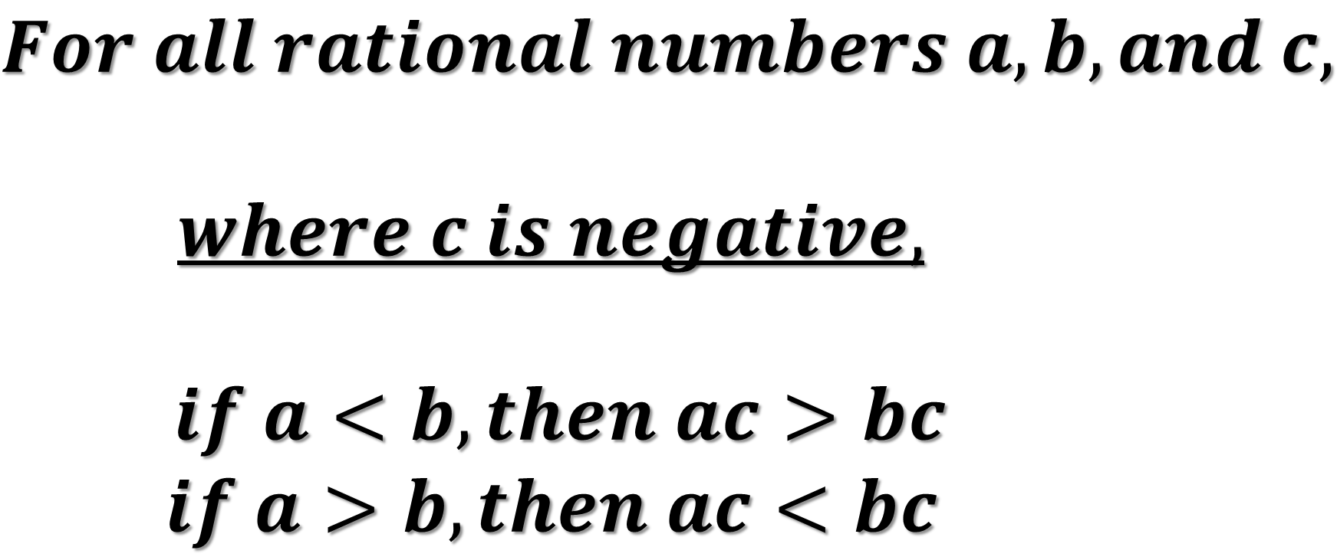
Multiplication Property of Inequalities
$$For all rational numbers a, b, and c,$$
$$where c is negative,$$
$if a<b, then ac>bc$
$$if a>b, then ac<bc$$

Slide 4
$$Ex.1)$$
$4x<$28

Slide 5
$$Ex.2)$$
$$9s>81$$

Slide 6
$$Ex.3)$$
$$−5y≤160$$

Slide 7
$$Ex.4)$$
$$−3y≥18$$

Slide 8
$$Ex.5)$$
$$−t<−5$$

Slide 9
$$Ex.6)$$
$$\frac{−x}{3}<−5$$

Slide 10
$$Ex.7)$$
$$3x<\frac{−5}{7}$$

